Slide 2
Follow Me:
Introduction to social media analysis in R
Maria Prokofivea, Saskia Freytag and Anna Quaglieri
R-Ladies/Victoria University (Australia)

Slide 3
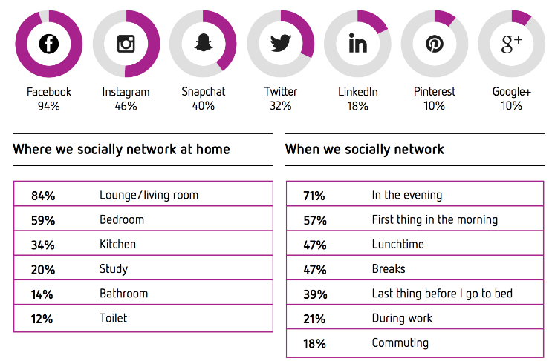
Social media
forms of electronic communication through which users create online communities to share information, ideas, personal messages, and other content (Merriam-Webster)
Social media census report 2017
Reasons for social media use:
catch up with family and friends (89%)
share photos or videos (57%)
watch videos (43%).

Slide 4
Social media analytics
gathering data from social media websites and
analyzing that data to make business decisions.
Key question: which social media platform? Which measurements? How to move on?
Examples: Who is your consumer? How to improve product/service?
What are uncovered needs/niches?
Twitter and stock market

Slide 5
Social media analytics trends
Metrics: demise of “vanity” metrics (likes, dislikes)
Focus: from engagement to lowering costs and attracting talent
Decline of corporations and government trust, the rise of micro-influencers
Social commerce
Social listening: tracking conversations, identify recurring phrases, words or brands, identify uncovered demands and opportunities
Influential “crowdcultures”

Slide 6
Structure of the social media data
Graph API: "the global mapping of everybody and how they're related”, introduced by Facebook in May 2007,
Components:
nodes —individual objects (e.g. a User, a Photo, a Page, or a Comment)
used to get data about a specific object, accessed by a unique ID (e.g. official Facebook Page has the ID 20531316728)
edges — connections between a collection of objects and a single object (e.g. Photos on a Page, Comments on a Photo)
used to get collections of objects on a single object, accessed by node ID and the edge name
fields — data about an object (e.g. User's birthday, Page's name)
Used to get data about a single object or each object in a collection.

Slide 7
Why OAuth 2.0 protocol
Client-server authentication model:
client requests access-restricted resources on the server using the resource owner’s credentials
Third-party access: the owner needs to share credentials
Limitations:
credentials are shared and stored for future use,
password authentication – security weakness
duration of access is hard to control
changing password
OAuth – introduces an authorisation layer to separate the owner from the client
The client requests access to resources controlled by the owner and hosted by the server
The client is issued a different set of credentials (vs resource owner) – access token

Slide 8
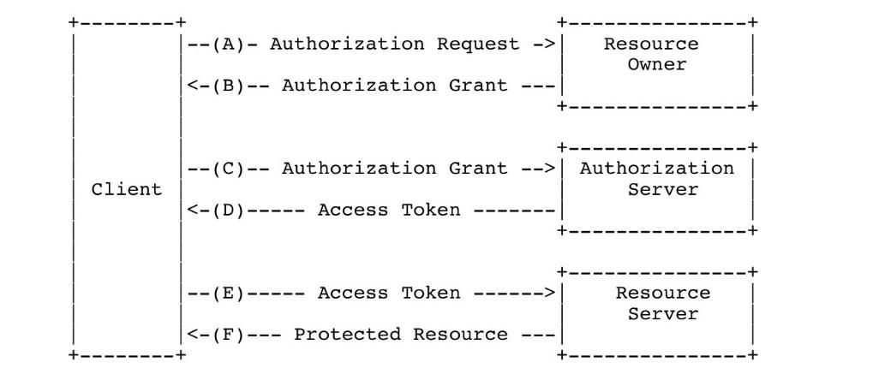
OAuth 2.0 protocol
industry-standard protocol for authorization
allows entities (e.g. User or a Page) to authorize tokens
usually authorization is done through a web interface
once authorized, apps can use tokens to access specific information
The OAuth Bible

Slide 9
Access token
an opaque string that identifies a user, app, or Page and can be used by the app to make API calls
includes information about when the token will expire and which app generated the token
Privileges of the client (what data can and cannot be accessed)
Examples of tokens (platform dependent):
User access token: most commonly used type of token
obtained via a login dialog and require a person to permit your app to obtain one.
App access token: obtained via a server-to-server call
Refresh token: used to obtain a new access token when the current access token expires

Slide 10
Client Identifier
A unique string that represents the registration information provided by the client
Public
Must not be used alone for client authentication

Slide 11
Protocol endpoints (HTTP resources)
Authorization endpoint: used by the client to obtain authorization from the resource owner via user-agent redirection
Token endpoint: used by the client to exchange an authorization grant for an access token, typically with client authentication
Redirection endpoint: used by the authorization server to return responses containing authorization credentials to the client via the resource owner user-agent

Slide 12
Facebook
https://developers.facebook.com/docs/facebook-login/
Birth: 2007. Wild Wild West. Vast data mining opportunities
2014: security measures to allow users decide what information they share with their apps.
April 2018: new app review process and more data protection. Severe cuts for data mining opportunities
May 2018: more data protection and security restrictions, enhanced developer app review and Graph API 3.0
July, 2, 2018: Facebook Login changed again. More protection, more security. Can we get any data from Facebook now? RIP https://developers.facebook.com/docs/facebook-login/changelog#2018-07-02

Slide 13
Instagram
https://www.instagram.com/developer/
Birth: October 2010
January 2018: Instagram Graph API announced
April 2018: severe restriction on API capabilities, closed and deprecrated major Instagram API endpoints.
older Instagram API is deprecated on July 31, 2018

Slide 14
Twitter
https://developer.twitter.com
Birth: 2006
April 2017, the Account Activity API is announced
GET READY: API major update August 16th

Slide 15
Social media - Predictive analytics

Slide 16
Text analysis
Text pre-processing
Word frequencies
Word clouds
Sentiment analysis
Topic modelling
Results
R packages:
stringi
dplyr
readr
readtext
R packages:
tidytext
tm
wordcloud topicmodels

Slide 17
Data preparation: Importing text
Download from social media
Flat text files (e.g. CSV and TXT)
Manipulations:
Parsing: joining, splitting, and extracting parts of strings
Use regular expressions to find or replace patterns
low-level string operations: e.g. removing html tags

Slide 18
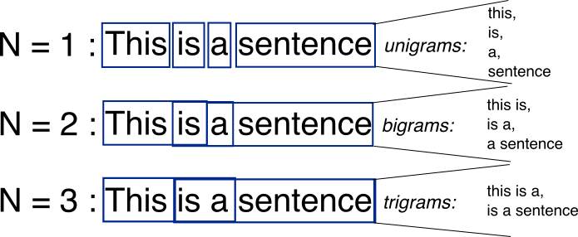
Data preparation:
Tokenization: unstructured data -> structured data
Split the text into smaller linguistic units, e.g. words, punctuation, numbers (“Los Angeles” and “rock 'n' roll”?)
words are separated by whitespace, punctuation marks or line breaks
Which token to use
Ngrams: consecutive sequences of words
“hello world”

Slide 19
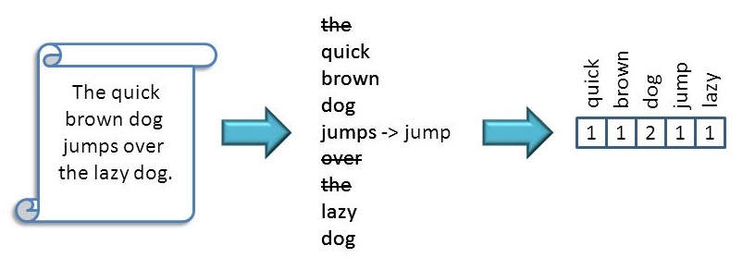

Data preparation:
The quick brown fox jumps over the lazy dog
The quick brown dog jumps over the lazy dog
Lowercasing and stemming:
reducing words to their root form
Regular expressions:
Link , regex cheatsheet
E.g. Remove html text, but keep retweets
Stopwords: most common words in a language
the, is, at, which, and on
Be careful! "The Who", "The The", or "Take That"

Slide 20
Text corpus: tidy data
Tidy data: a table with one-token-per-row
Each variable (=token) is a column
Each observation is a row
Each type of observational unit is a table
A token: a meaningful unit of text (e.g. a word, n-gram, sentence, or paragraph)
Tokenization: splitting the text into commonly used units of interest.
can be less memory efficient and make matrix algebra less easily applicable

Slide 21
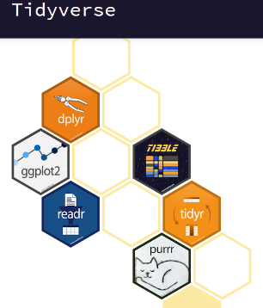
Tidyverse
Tidyverse is a collection of R packages for data science (text analytics!)
Package list
Dplyr: data manipulation made easy:
mutate() adds new variables that are functions of existing variables
select() picks variables based on their names.
filter() picks cases based on their values.
summarise() reduces multiple values down to a single summary.
arrange() changes the ordering of the rows.
Piping %>%
Most common use
x %>% f is equivalent to f(x)
x %>% f(y) is equivalent to f(x, y)
x %>% f %>% g %>% h is equivalent to h(g(f(x)))
Tutorial

Slide 22
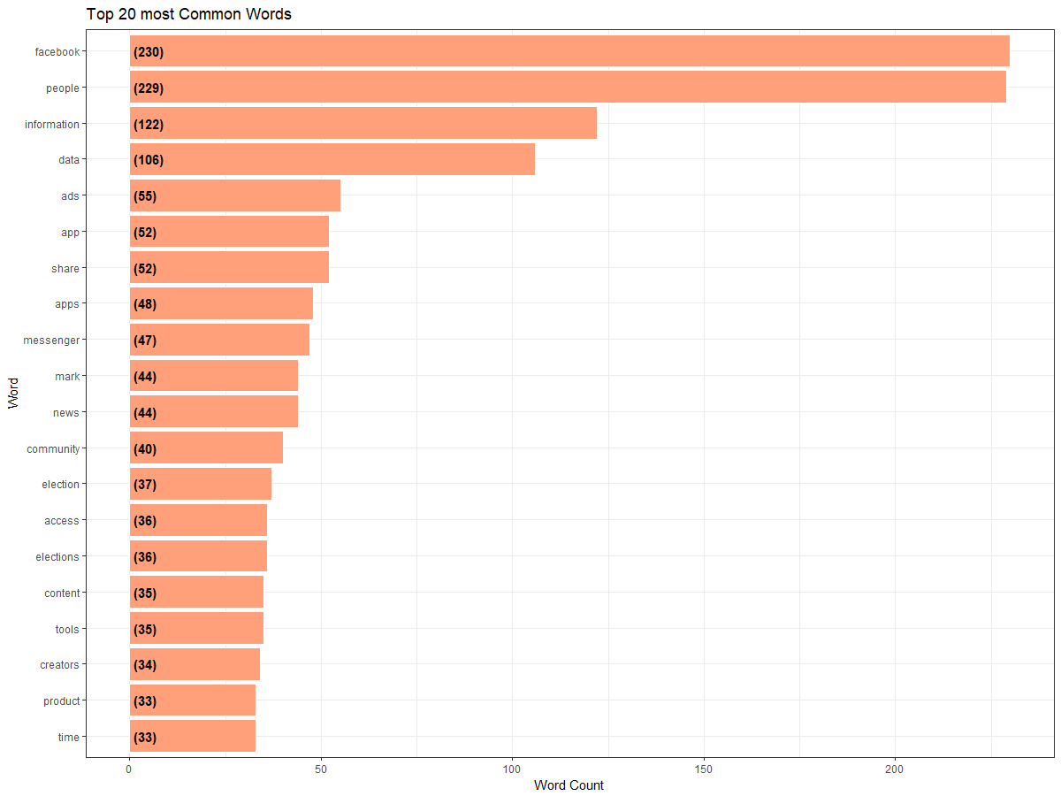
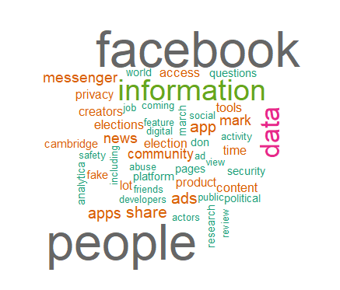
Visualising text data
Word Frequency:
see trends and patterns
check accuracy of pre-processing
Word Clouds: A picture is worth 1,000 words.

Slide 23
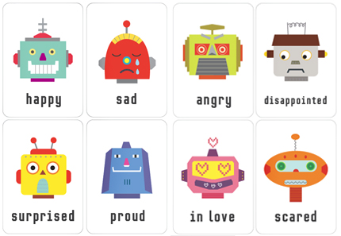
Sentiment analysis
loughran
What are the emotions behind the words? What is the public opinion behind certain topics?
Opinions are key influencers of our behaviors
Whenever we need to make a decision, we often seek out the opinions of others.
Individuals: seek opinions from friends and family
Organizations: use surveys, focus groups, opinion polls, consultants.

Slide 24
Sentiment analysis: uses
loughran
Multiple!
Stock exchange market: change in social media sentiment predict share prices
Politics: new policy announcements, election, public moods
Marketing: consumer opinion, benchmark products and services; market intelligence
Neuro-linguistic programming (NLP): “the conscious mind is the goal setter, and the unconscious mind is the goal getter”
Identifying and using the thinking strategies and emotional states
Individuals: Make decisions to buy products or to use services, find public opinions about political candidates and issues

Slide 25
What are your emotions?
сonstructed via either crowdsourcing (using, for example, Amazon Mechanical Turk) or
by one of the authors,
validated using some combination of crowdsourcing again, restaurant or movie reviews, or Twitter data.
Most general-purpose lexicons are
AFINN from Finn Årup Nielsen
negative, positive
assigns words with a score that runs between -5 and 5, with negative scores indicating negative sentiment and positive scores indicating positive sentiment.
bing from Bing Liu
positive and negative categories.
Loughran lexicon
"litigious", "uncertainty", "constraining", and "superfluous".
nrc from Saif Mohammad and Peter Turney:
Emotions: anger, anticipation, disgust, fear, joy, sadness, surprise, trust

Slide 26
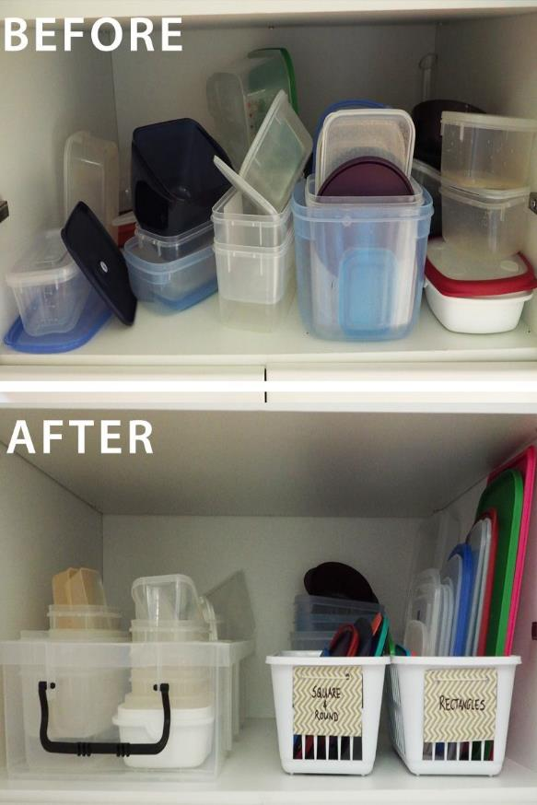
Topic Modelling
classification of documents (similar to clustering on numeric data!)
unsupervised - we do not know what to look for before we start!
put items into “natural” groups
Latent Dirichlet allocation (LDA)
each document as a mixture of topics, and each topic as a mixture of words.
documents can “overlap” each other- do not need to separate them into discrete groups (very natural language like!)

